Slide 1
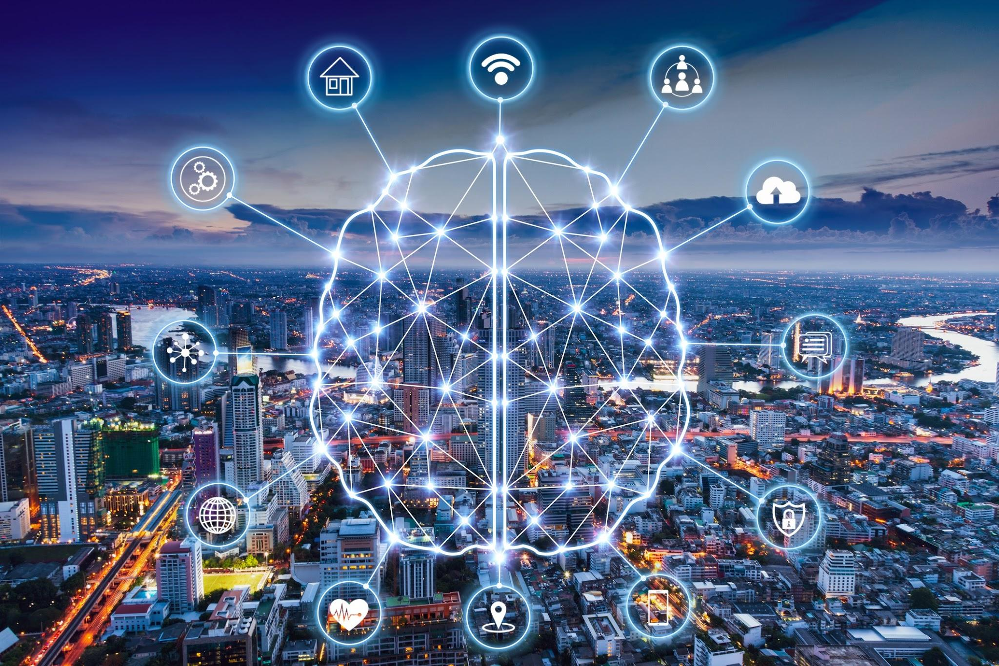
SMART CAMPUS
SMART CAMPUS

Slide 2
Submitted By :
Or Abutbul Moran Ron
Anri Ben Zion Linoy Ron
Lior Avrahami Shir Davidov
Ram Pakanayev

Slide 3
Introduction
Internet Of Things (IOT) is a system of interrelated computing devices , sensors , mechanical and digital machines and a lot more , that possess the ability to transfer data over a network without requiring human-to-human or human-to-computer interaction.
Wikipedia

Slide 4

OUR PROJECT
A real-time system with an interactive web interface that monitors the various activities on campus, and allow the user to get information about the different facilities on campus.
The system includes management and control of various communication components within the organization and in real time.

Slide 5
Stakeholders:
Administrative manager:
Residents:
Organizational Management:
shortening of management times of issues will lead to a better campus conditions and satisfaction of residents in the campus.
The system will make it possible to optimize the organization`s consumption.
As a result , it will reduce administrative management times.
It will allow to focus on other issues of interest.
Accurate statistics on organizational habits (electricity , water usage and more) will reflect the real needs of the campus , which can lead to better efficiency in campus needs.
DIRECT STAKEHOLDER
INDIRECT STAKEHOLDERS

Slide 6



System Design - Architecture
Chillers
Python
PostgreSQL
JS
React

Slide 7
Development Stages - Backend:
Database
ThingsBoard
Backend
Create tables
Create schemes & Indexes
Export the server to campus PC
Demo of the visualization
Get data from chillers
Create endpoints for client
Create queries to the DB

Slide 8
IN THE FUTURE:
Adding sensors about parking spaces in the campus.
Uploading the server (that include the DB) on HIT PC.
Adding more sensors such as: amount of people at a building, Electric chillers

Slide 9
Conclusion :
The internet of things is a concept that will have an enormous effect on the world. Many people are still skeptical about this idea and whether or not it will have a negative or positive impact on society. Like it or not, we will eventually reach a point where almost everything we use is connected to the internet in some way.
Our Project can help with various things :
Accurate statistics about usage at the campus
A way to monitor the situation in a smarter way
Ability to save in consumption of electricity and water usage

Slide 10
Bibliography:
https://thingsboard.io/
https://en.wikipedia.org/wiki/Internet_of_things
https://www.interviewbit.com/blog/iot-architecture/
https://ecda.eur.nl/smart-campus-project/

Slide 11
THANKS!
DO YOU HAVE ANY QUESTIONS?

